Slide 1
The Heterogeneous Effects of R&D Tax Incentives and the Role of Policy Mix
Findings from the 1st phase of the OECD microBeRD project
R&D and Innovation Policies for the Marketplace
Lisbon, 16th September 2019
Silvia Appelt, Matej Bajgar,
Chiara Criscuolo, Fernando Galindo-Rueda
OECD Directorate for Science, Technology and Innovation
Notes:
Findings from microBeRD project
Joint work with Silvia, Chiara and Fernando
Co-funded by EC

Slide 2
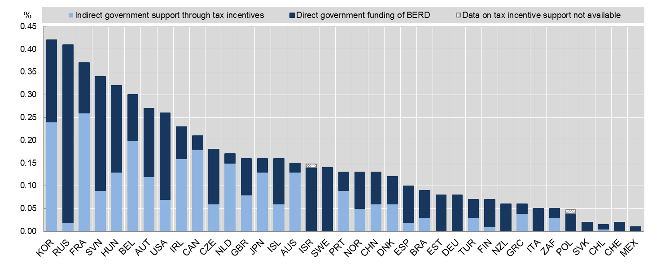
R&D tax incentives matter!
Direct funding and federal tax support for business R&D, 2013 (% GDP)
Source: OECD STI Scoreboard 2015, based on OECD, R&D Tax Incentive Indicators, www.oecd.org/sti/rd-tax-stats.htm and Main Science and Technology Indicators, www.oecd.org/sti/msti.htm, June 2015.Statlink: http://dx.doi.org/10.1787/888933274317.
Notes:
Focuses mainly on R&D tax incentives, which are in many countries a key tool for promoting business R&D
Shows the share of GDP spent on public support; bright is tax, darker is direct
Belgium, Portugal and Norway all high marginal rates, but more costly in Belgium – related

Slide 3
Design and heterogeneity matters!
  Example 1: R&D tax incentives in Portugal
  1-B-Index by firm size and profit scenario
Notes:
Shows 1-B-Index = the amount of subsidy on 1 euro of marginal R&D for different types of firms
Portugal tax credit
Volume-based + incremental (previous 2 years)
Carry-forward but no refund
Ceiling only on incremental
Special rate on start-ups
Suspended

Slide 4
Design and heterogeneity matters!
  Example 2: R&D tax incentives in Norway
  1-B-Index by firm size and profit scenario
Ceiling of
NOK 4 million
Ceiling of
NOK 25 million
Notes:
Norway
Volume-based
Refund
Slightly rarger rate for SMEs
Ceiling – increased over time

Slide 5






Approaches to studying R&D tax incentives
Firm-level single-country
Aggregate cross-country
Firm-level cross-country
microBeRD
Notes:
Firm-level single-country
Many details
But limited variation across firms and over time
Hard to generalise
Aggregate cross-country
Generalisible
But black box
Firm-level cross-country
combined benefits...
...but challenging - data availability, comparability, confidentiality

Slide 6









microBeRD:
Distributed microdata approach
As seen on... Dynemp and Multiprod
Confidential national microdata
Non-confidential harmonized output
Statistical code
Incentive design information
R&D survey data
Corporate tax data
1. Moments of firm distribution micro-aggregated regressions
2. Firm-level distributed regressions
Notes:
Distributed microdata approach
Projects on innovation, business dynamics and productivity
Collaboration between OECD and a network of national experts
OECD prepares code and experts run on representative confidential microdata (R&D survey and tax)
Non-confidential harmonised output

Slide 7
Micro-aggregated regressions
Methodology
  Country-size-industry-year
  Link R&D performance to user cost of R&D
  B-Index
  Control for many other factors
  value added, country-industry-size FE, industry-year FE, size-year FE
Notes:
Aggregate microdata up to country-industry-size-year level
Link R&D performance to user cost (B-index)
Control for other factors – value added and rich fixed effects

Slide 8
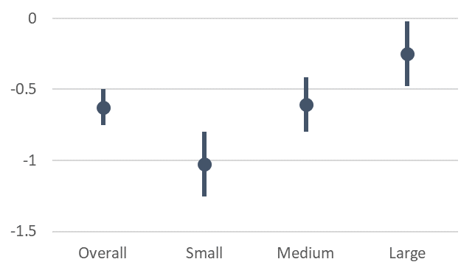
Micro-aggregated regressions
Estimated R&D user cost elasticities
1.0
1.4
0.9
0.4
Implied gross incrementality ratios
Notes:
Average Elasticity of -0.6, i.e. 10% reduction in price = 6% increase in R&D
Varies linearly with firm size: -1 for small firms but -0.3 for large
This means 1 euro generates 1 euro overal but 1.4 for small and 0.4 for large
Explains large effects in firm-level studies

Slide 9
Micro-aggregated regressions
Size or R&D performance?
Note: All regressions control for log(value added), country-industry-size FE, industry-year FE and size-year FE. Standard errors clustered at country-industry-size level. Countries: AUS, AUT, BEL, CHE, CHL, CZE, DEU, ESP, FRA, ISR, ITA, JPN, NOR, PRT, SWE.
Notes:
Dig deeper
Size
Average R&D expenditure
Industry R&D intensity
It is average R&D expenditure (rather than size per se)

Slide 10
Micro-aggregated regressions
Additional results
among existing & new R&D performers
R&D capital and extramural R&D
No wage effects ( part-time R&D employment)
Exp. development vs. research
Notes:
Increase both among existing performers (intensive margin) and new performers (extensive margin)
Stronger for R&D capital and extramural R&D – make them eligible!
Increase in part-time employment but no wage effects
Stronger effect for experimental development than for basic and applied research

Slide 11
Firm-level regressions
Methodology
Leveraging tax relief microdata
  3 types of DiD analysis
  Tax relief beneficiaries vs. non-beneficiaries
    AUS, AUT, BEL, CHL, FRA, JPN, NOR, SWE
  Tax incentive change: affected vs. non-affected firms
    AUS, BEL, CHL, CZE, FRA, NOR, PRT, SWE
  Direct support beneficiaries vs. non-beneficiaries
    AUS, AUT, CHL, CZE, DEU, FRA, ITA, JPN, NOR, NZL, PRT, SWE
Notes:
Now firm-level regressions – produce separate estimates for each country
3 methods
Matching estimator comparing tax relief recipients and non-recipients
Estimator comparing firms affected by a particular reform to those not affected
Matching estimator comparing beneficiaries and non-beneficiaries

Slide 12
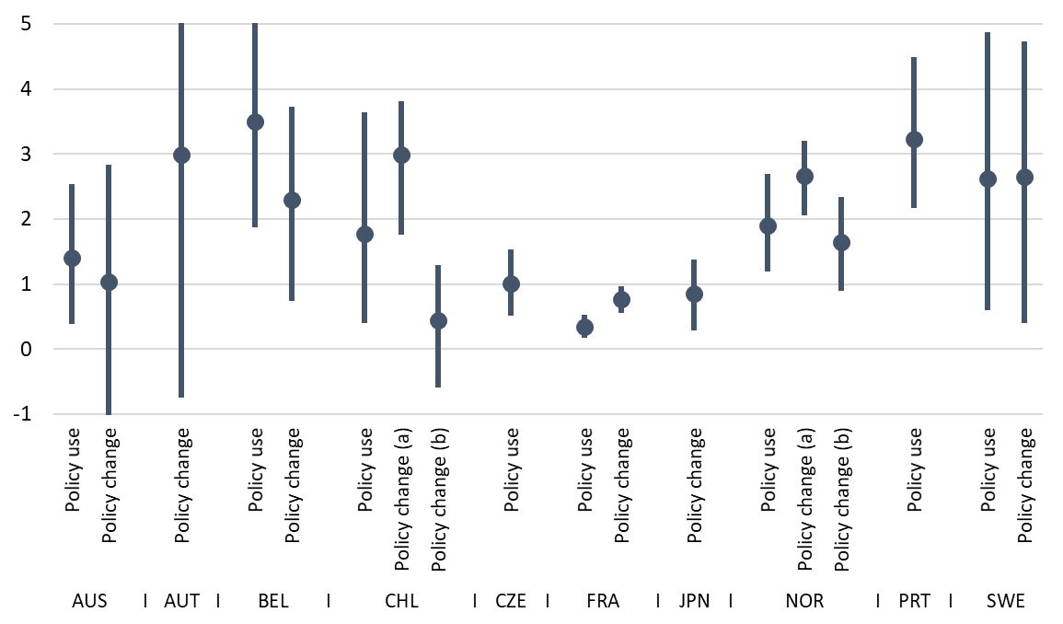
Firm-level regressions
Input additionality by country and method
Notes:
Positive effects with wide variation between 0.35 and 3.5
Consistent with bigger effects on smaller firms: for France 1 for low-R&D firms
In Norway results consistent with Marina‘s, high as many low-R&D firms use
Portugal high incrementality, likely due to incremental nature

Slide 13
What does this mean?
  Input additionality
  0.4 (large) vs. 1.4 (small)
  (driven by level of R&D)
Heterogeneity and design matter!
R&D ceilings/thresholds likely to increase overall input additionality
  But spillovers stronger for larger firms? (Bloom et al., 2013)
How to incentivize large R&D performers?
  Mission-oriented policies? Procurement?
Notes:
Input additionality 0.4 for large and 1.4 for small; driven by level of R&D performance
Important to understand heterogeneous effects and role of design
Results suggest that R&D ceilings and tresholds will increase overal input additionality, but input additionality is not all and spillovers might be stronger for larger firms
How then incentivise large R&D performers. Mission-oriented policies? Procurement?

Slide 14


Thank you
matej.bajgar@oecd.org

