Slide 1



R&D and Innovation Policies for the Marketplace
Joint workshop on firms, industries and productivity
Lisboa (INE) | September 16, 2019

Slide 2


Slide 3
From R&D to the Marketplace @ Critical

Slide 4


The University of Coimbra was founded
CSW-QMS-2015-TPL-00368, V6, 2017-09-05
© COPYRIGHT 2017 CRITICAL SOFTWARE
4

Slide 5
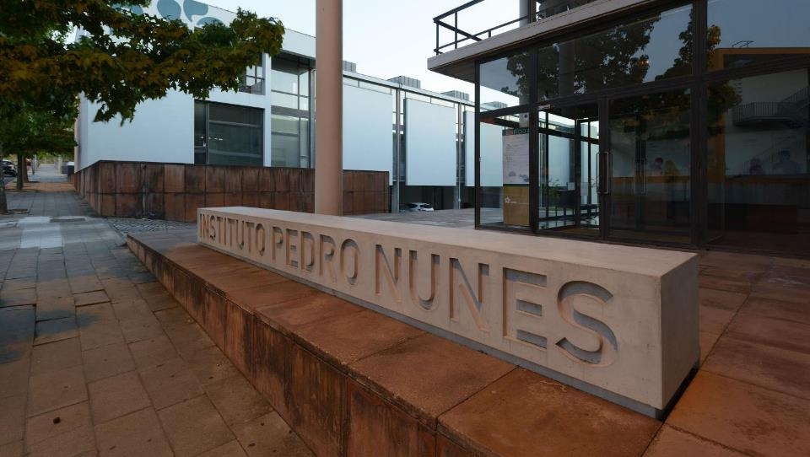


CRITICAL Software was founded
A 20 year Journey
Adaptability, Agility
Discipline, Result Orientation
CSW-QMS-2015-TPL-00368, V6, 2017-09-05
© COPYRIGHT 2017 CRITICAL SOFTWARE
5

Slide 6



LAUNCH
?
CAN YOU
RELY
ON YOUR
SOFTWARE
© Copyright Critical Software. All rights reserved. CSW-QMS-2017-TPL-02018, V2, 2019-03-07

Slide 7

To provide systems, software, and services for mission and business critical applications
CSW-QMS-2015-TPL-00368, V6, 2017-09-05
© COPYRIGHT 2017 CRITICAL SOFTWARE
7

Slide 8
Innovation Cycle - 1999
R&D Partners
Critical
Marketplace
Technology
Knowledge intensive,
Fewer competitors & entry barriers,
Credibility/Reputation
Technology Transfer
Niche
R&D in CONSORTIUM
Services,
Solutions
Mass
Market
IP / Quality Innovation / Mkt
VOLUME /GROWTH
SINERGIES
PARTNERSHIPS
Funding

Slide 9







The Push&Pull model
  R&D in Consortium with
  Universities / R&D Labs
Ideas
Push-Pull

Slide 10
Innovation and R&D - 2007
R&D
Innovation
  R&D in Consortium with
  Universities / R&D Labs
Innovation Process
  Input: KNOWLEDGE
  (supported by assets):
    Ideas (typically coming from the market, or knowledge centers)
    Worked out via prototyping, R&D, partnerships with customers, etc..
  output: VALUE in the market
Valley of Death
  What goes between the idea and its ability to generate value in the market
R&D
Mass-Mkt
Product
Ideas
R&D
Mass-Mkt
Product
10
Proto
Research Arena
Market Arena

Slide 11
Innovation and R&D - 2007
R&D
Innovation
  R&D in Consortium with
  Universities / R&D Labs
Innovation Process
  Input: KNOWLEDGE
  (supported by assets):
    Ideas (typically coming from the market, or knowledge centers)
    Worked out via prototyping, R&D, partnerships with customers, etc..
  output: VALUE in the market
Valley of Death
  What goes between the idea and its ability to generate value in the market
R&D
Mass-Mkt
Product
Ideas
R&D
Mass-Mkt
Product
11
Proto
Research Arena
Market Arena

Slide 12
















Mngmt
by out

Slide 13
R&D and Innovation Policies for the Marketplace
Joint workshop on firms, industries and productivity
Lisboa (INE) | September 16, 2019

