Slide 1
Growth for Good: Reshaping Capitalism to Save Humanity from Climate Catastrophe
Alessio Terzi
The views expressed here are solely those of the author.

Slide 2
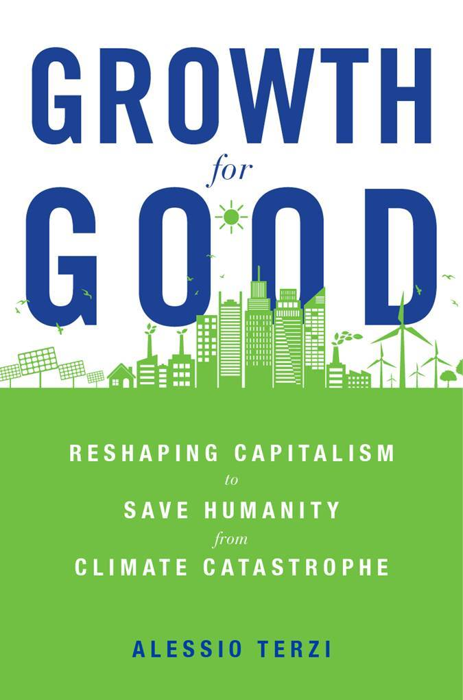
The book
Product Details
HARDCOVER
$29.95 • £23.95 • €27.00
ISBN 9780674258426
Publication Date: 05/24/2022
Trade book
368 pages
6-1/8 x 9-1/4 inches
16 illus., 2 tables
World

Slide 3


The genesis

Slide 4
The (un?-)holy trinity
Capitalism
Nature
Growth

Slide 5
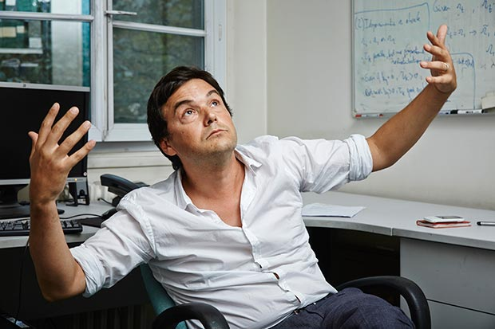
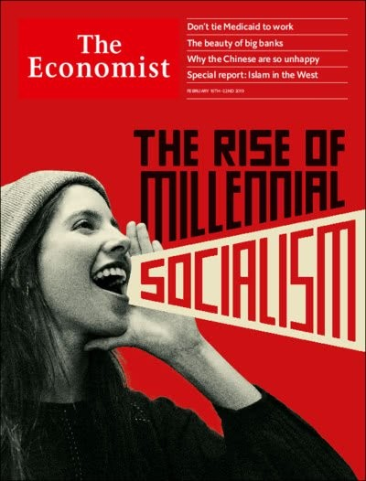
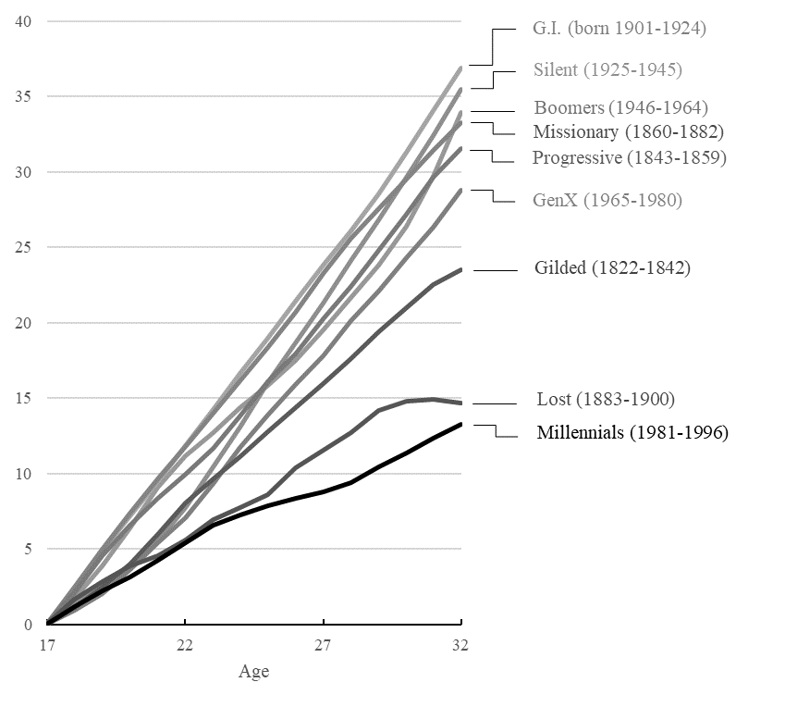

Millennial Socialism
+ inequality
+ environmental awareness
Cumulative real GDP per capita growth during each generation’s first 15 years in the workforce, starting at 18 years of age, averaged across birth years.

Slide 6
The first part of the book
Conclusion 1:
Abolishing growth would be incompatible with capitalism
→ It requires a complete societal restructuring
Capitalism
Nature
Growth
Implication:
If you call to abolish growth, then you must be ready to provide the blueprint for an alternative society

Slide 7
Degrowth: Ecosocialism & steady state economy
Capitalism
Nature
Growth
& a better sharing of available/limited resources embracing sufficiency

Slide 8
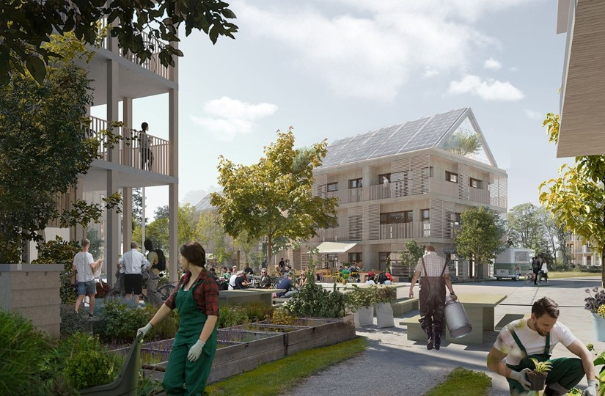
Degrowth policy conclusion
Abandon economic growth and hyper-consumerism in advanced economies
Leave space for further economic growth in poor countries
Continue R&D, but (centrally) focused on green transition
Embrace a life-style of sufficiency (e.g. Eco-villages)
Produce locally
Direct/collegial democracy

Slide 9
G4G comes to different conclusions
Growth and inequality: a steady state environment exacerbates conflict within and between societies over limited resources
this is because..
The growth imperative: is not an imposition of “the system” over otherwise indifferent people. But rather, humans have an inbuilt ‘desire for more’..
Which ultimately originates from…
Growth and technology: the desire to use technology and knowhow to shape the world, and therefore self-determination as a species.

Slide 10
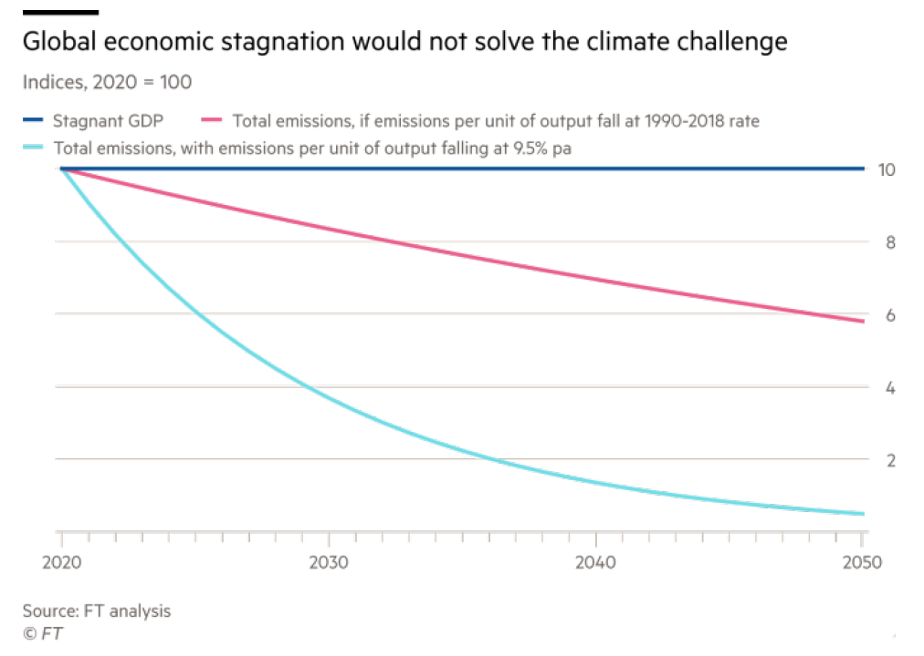
Tech acceleration even in steady state
Halting economic growth alone will hardly suffice to achieve net zero
This can only imply two things:
Either you need a sharp reduction in GDP per capita in rich countries (in the order of magnitude of -60%, as estimated by degrowth economist Peter Victor, 2012)
Or, you need to continue accelerating on green R&D and adoption

Slide 11
Growth and nature
Conclusion:
Growth did not start with the Industrial Revolution and has always been about achieving more needs/wants using knowhow/tech, while managing our relationship with nature. The *current* growth model (based on fossil fuels) no longer fulfils this condition
Capitalism
Nature
Growth
Implication:
A *different* / reshaped type of capitalism & growth is needed

Slide 12
The overarching message
Avoiding a climate disaster goes through a restructuring of the whole economy and a switch to green technology
Capitalism can be a forceful ally, by fostering the development and deployment of green tech
However, this will not happen on its own, and surely not at the speed required (climate neutral by 2050)
Actions required by governments (but also pioneering businesses and engaged citizens)
‘Whole-of-nation’ approach

Slide 13

Technology and just transition
We are talking about transformation on the scale of an Industrial Revolution
Policy will accelerate this even more, to achieve climate goals and avoid the worst outcomes
Some areas/regions/professions will be left behind. Cultural views will be shattered
→ Green policy and inclusive social policy must proceed hand in hand or people will oppose the transition

Slide 14
There is much more in the book
Discussion on the interplay between growth, wellbeing and liberal democracy (Ch. 2)
A zoom-in on Italy as a case study of the negative dynamics unleashed in a steady state economy (Ch. 4)
International cooperation in the face of climate change (Ch. 7)
Green macro, or else what happens to growth and jobs if we implement Green Deals (Conclusion)

Slide 15

The cost of greening
According to one narrative..
Green transition represents large costs in the short term
  “The green option is more expensive”
It is not really an investment opportunity, because in the best case scenario we simply get to keep what we already have
  Think ICE -> EV
  More like military expenditure. A necessary evil
It creates stranded assets
→ Macro models suggest muted impact on
GDP (and net job creation)

Slide 16
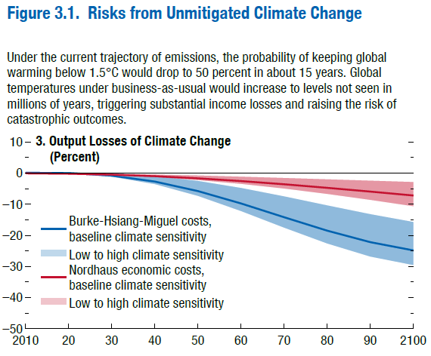
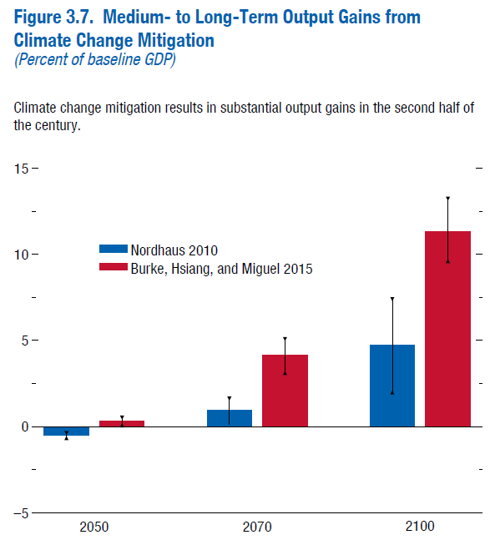
Defining the baseline
Source: IMF (2020)
→ Poor integration of economic and climate models (CEA, 2022; Pisani-Ferry, 2019)

Slide 17
The Green Deal economy
Typically, the green transformation is modelled as a tax shift, from labour to carbon
But of course Green Deals are much more, encompassing large public investment plans, subsidies to green R&D, carbon border adjustment, etc.
More broadly, the green transition will require a complete transformation of basically all of production, consumption, agriculture, housing, transport..
…and in essence the whole structure of the economy
→ (Green) Lucas Critique (Terzi, 2022b)

Slide 18

The Green Industrial Revolution
Because of how wide-reaching and all-encompassing the green transformation will be, it is probably a better comparison to the way Industrial Revolutions played out, implying..
A complete recasting of comparative advantages across the globe
Some countries/companies will emerge as winners, others will remain stuck in technologies that are perceived as old and lower quality

Slide 19

The history of energy transitions
In a majority of cases, a successful new energy source or technology provided the same service (i.e. heating, power, transport or light) with superior or additional characteristics (e.g. easier, cleaner or more flexible to use). Often, after their introduction, the price of the service they provided was higher than from the incumbent energy source. […] because some consumers were willing to pay a premium for those better or additional characteristics, these technologies could be refined and costs could fall gradually (Fouquet, 2010)
From | To
Residential coal | Gas in heating
Animals | Steam
Steam | Electricity
Horses | Railway
Sail | Steam ship (See Annex Slides)*
Railways | Combustion engine
Candles | Gas
Gas | Electricity
The Great Smog of London, Dec 5-9 1952

Slide 20
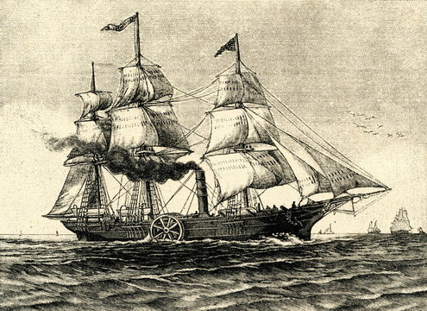
Case study: Steam ships
The first steamship crossed the North Atlantic no faster than the best contemporary sail ships with favourable winds (Smil, 2017)
From the first ships built, in 1815, to 1830, entrepreneurs saw the potential of steam power and pushed its expansion. […] Sailing ships improved efficiency and competitiveness after the introduction of steam ships, and grew in importance. Early steam ships were highly inefficient, requiring vast quantities of coal to fuel the voyage. Since they could less easily fuel-up on route than a train, the coal required displaced valuable space that might carry goods or passengers. It was not until major improvements in fuel efficiency in the latter part of the nineteenth century that it finally replaced the sailing ship (Fouquet, 2010)
SS Savannah, 1818

Slide 21
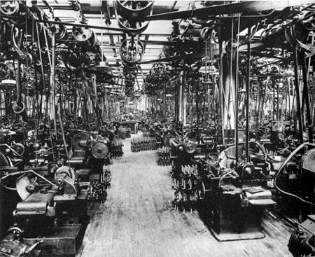
The Adam Smith fallacy
Critics would argue that green tech does not display a higher productivity than the polluting option. Hence, it is not an Industrial Revolution.
In the early stages on an IR, the new tech does not necessarily reflect higher productivity gains!
Trial and error with mechanisation initially led to widely dispersed productivity draws and low average productivity.
  In the subsequent decades, high productivity growth was observed, as new entrants adopted improved methods of production/organisation (Juhász et al, 2020)
The same with the Second IR
  Line shaft -> assembly line (Aghion et al, 2021)

Slide 22
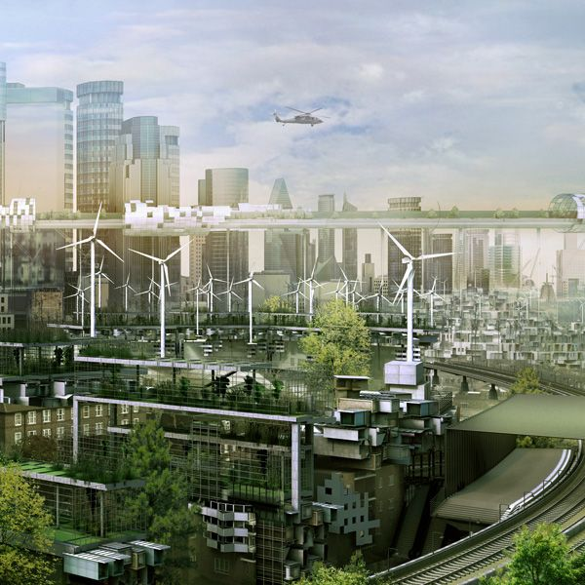
The scope for secondary innovation
Green innovation will not stop at replacing the polluting option with the green option
“For two hundred years, technologies based on fossil fuel have been explored. Diminishing returns may have set in. Climate change has induced new searches in other parts of the technology frontier. […] the green economy may usher in a new era of high productivity growth.”
Stern and Stiglitz (2021: 61)
Renewable energies could easily become by far the cheapest energy source in history (IEA, 2020)

Slide 23
Implications
It makes self-interested (commercial) sense to be at the forefront of the green transition, defining standards and steering the very course of the technological transformation
Governments cannot be expected to sit and wait to discover if their country ends up on the winning or losing end, just as they have during the First Industrial Revolution (Beckert, 2014)
  Active industrial policy, which lays the seed for defensive industrial policy
  Active use of trade (e.g. green clauses in trade treaties, carbon border tax, etc.)
There is no real trade-off for emerging markets between development and climate policies
  Largest export markets will progressively restrict polluting options
  Roll out in pioneering nations will make the green option the cheapest option also in EMs

Slide 24
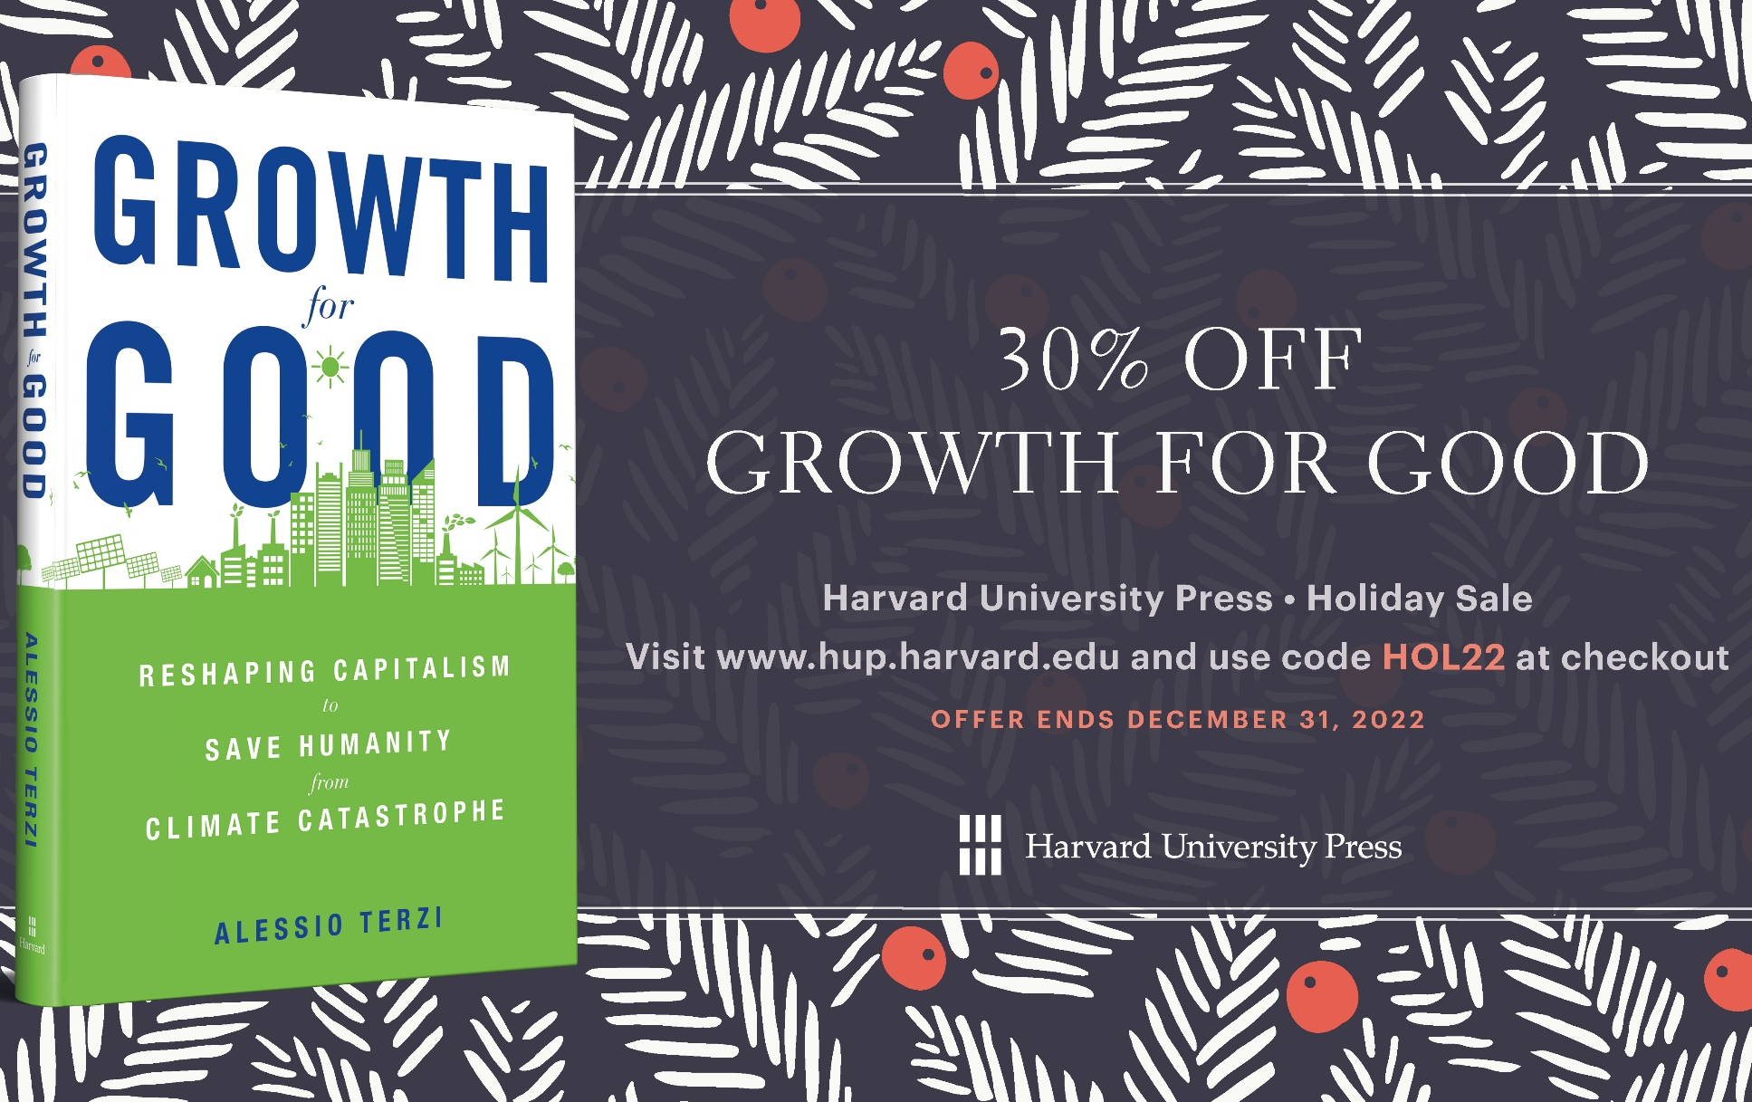
Thank you!
For questions/comments:
Alessio.terzi@sciencespo-lille.eu
Twitter: @terzibus
Mastodon: @terzibus@econtwitter.net
www.alessioterzi.eu

Slide 25
Bibliography
Aghion, P., Bunel, S., and Antonin, C. (2021), The Power of Creative Destruction, Cambridge, Massachusetts: Belknap Press.
Beckert, S. (2014), Empire of Cotton, New York: Penguin Books.
Council of Economic Advisers (2022), “Climate-related macroeconomic risks and opportunities”, White Paper, April 4.
Fouquet, R. (2010), “The slow search for solutions: Lessons from historical energy transitions by sector and service”, Energy Policy, Vol. 38, Issue 11, pp. 6586-6596.
IEA (2020), Renewables 2020 Report.
IMF (2020), “Mitigating Climate Change: Growth- and Distribution-friendly Strategies”, World Economic Outlook, Chapter 3.
Juhász, R., Squicciarini, M., and Voigtländer, N. (2020), “Technology Adoption and Productivity Growth: Evidence from Industrialization in France”, NBER Working Paper No. 27503.
Pisani-Ferry, J. (2019), “A Credible Decarbonization Agenda Can Help Strengthen Europe's Economy”, PIIE Blog, December 9.
Smil, V. (2017), Energy and Civilization, Cambridge, Massachusetts: MIT Press.
Terzi (2022a), Growth for Good, Cambridge, Massachusetts: Harvard University Press.
Terzi (2022b), “A Green Industrial Revolution is Coming”, VoxEU, forthcoming.

