Slide 1
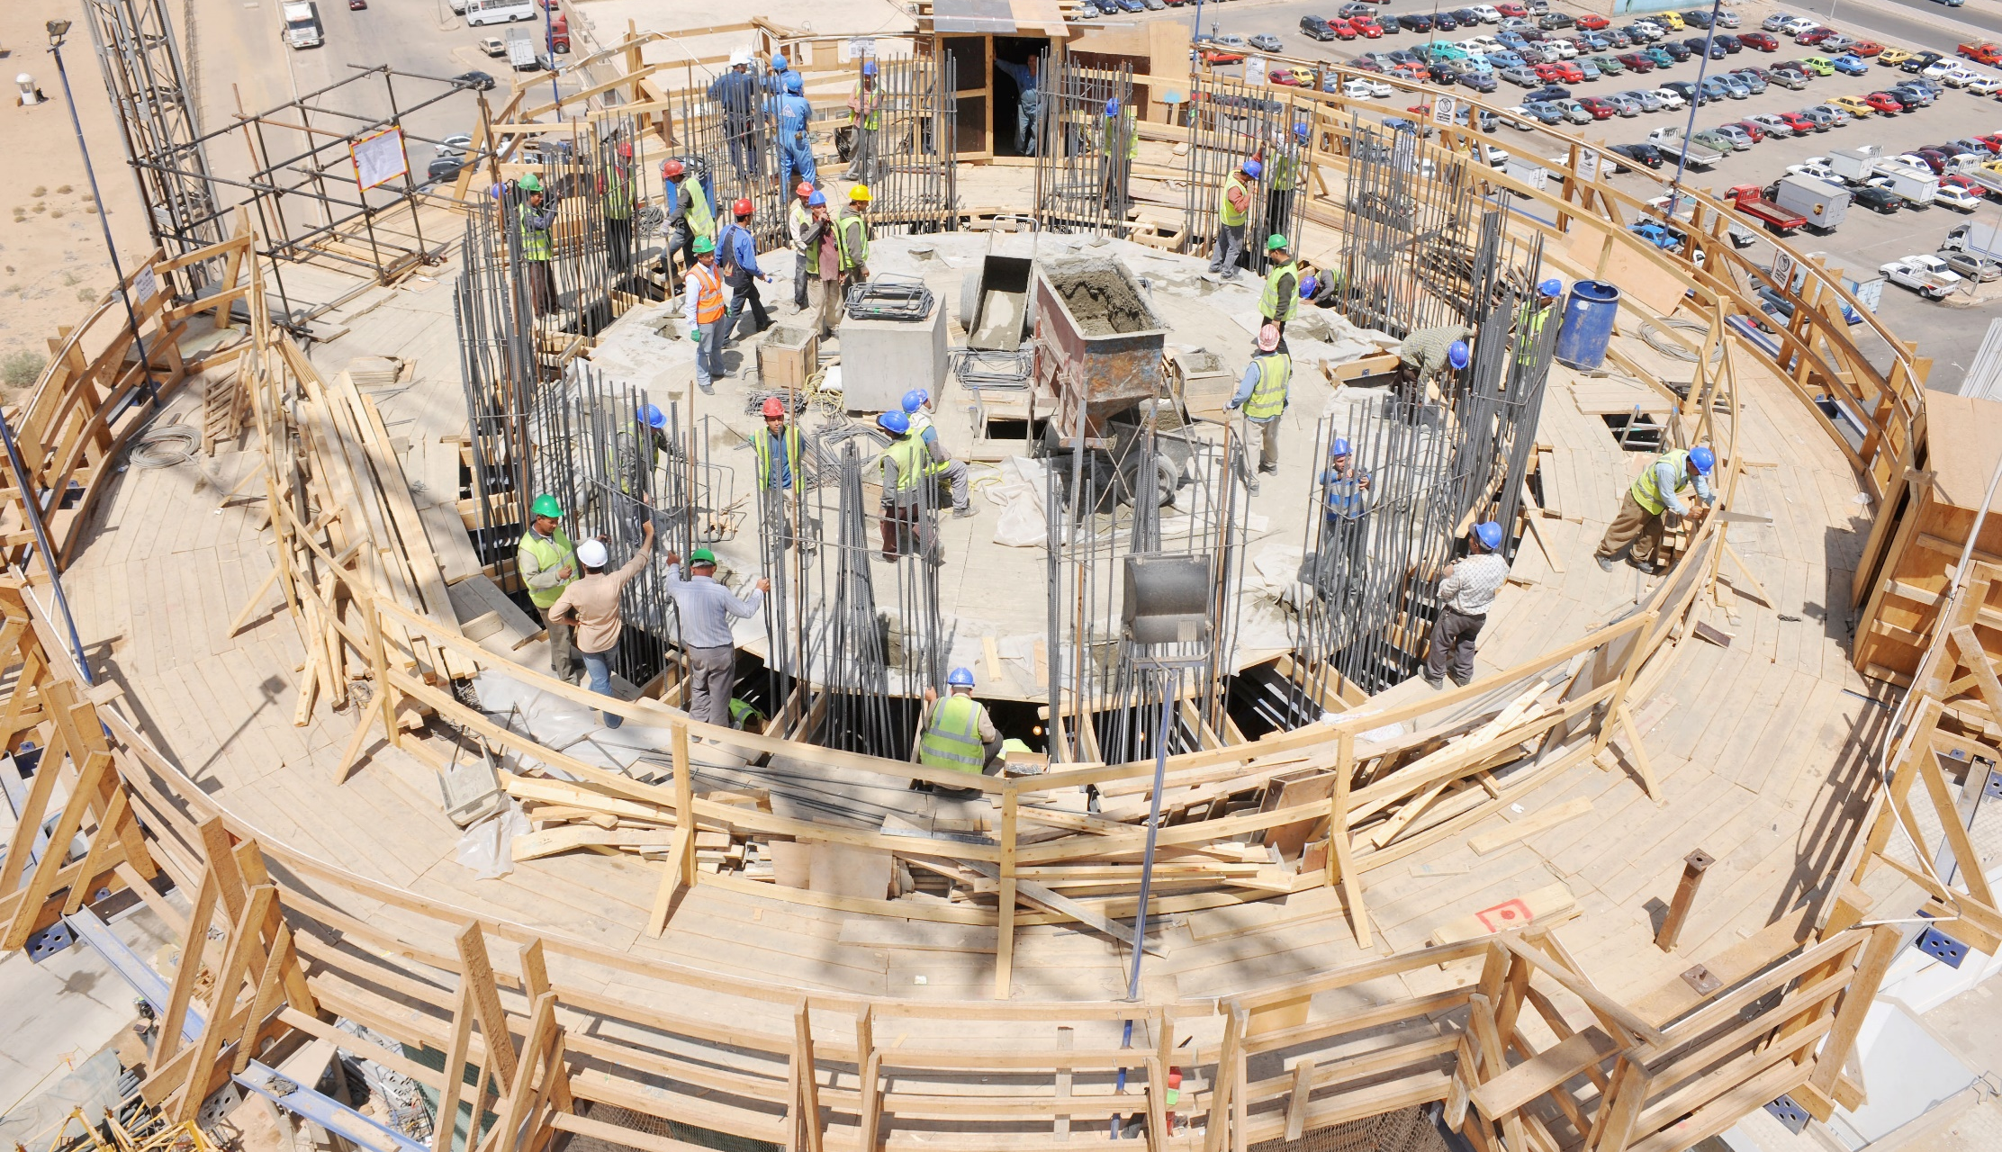
Impact of the COVID-19 Crisis on Employment Around the World
  Maurizio Bussi
  Deputy Regional Director for Europe and Central Asia, ILO

Slide 2
A central policy challenge
Primary focus on implementing and monitoring public health measures…..
….while maintaining an adequate and sustainable level of economic activities

Slide 3
Overview
The socioeconomic impact of COVID-19 – a global overview
Some observations on Portugal
Policy strategies for a robust, sustainable and inclusive recovery
Q&A

Slide 4
ILO support to constituents
Broadly speaking, two lines of support
  Technical Advisory services: physical and legal measures to contain spread of COVID; extending scope and coverage of social protection; protecting the vulnerable; supporting business continuity
  Broadening the knowledge base for the socioeconomic impact of the crisis: ILO Monitor (six editions), sectoral briefs, thematic briefs (social protection, effects on SMEs, role of International Labour Standards, strategies to help informal workers, etc.)

Slide 5
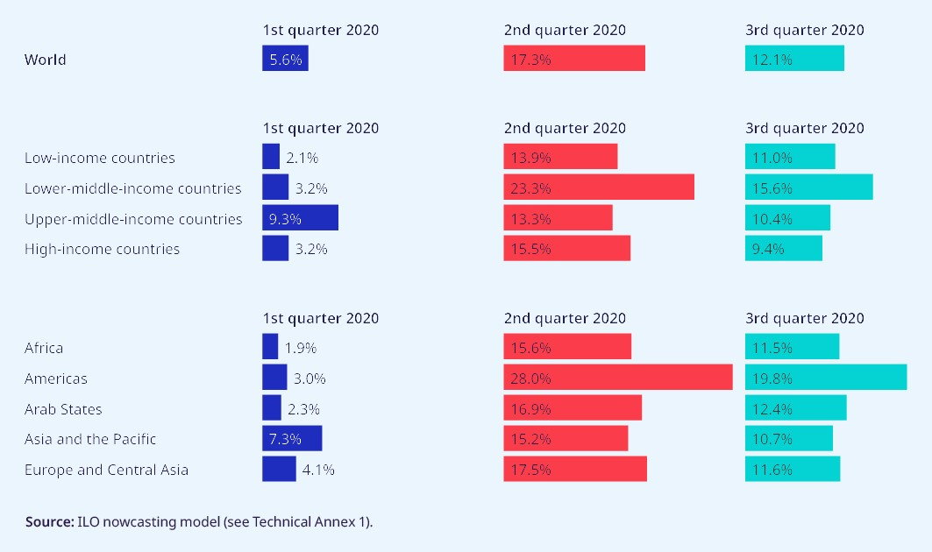
COVID-19 crisis has damaged economies and labour markets around the world
  Working-hour losses in 2020Q2 (relative to 2019Q4) estimated at 17.3%, or 495 million full-time equivalent (FTE) jobs
  Global labour income is estimated to have declined by 10.7%, or US$ 3.5 trillion, in the first three quarters of 2020
  Lower-middle-income countries and some regions (esp. Americas) have been hard hit
  Certain sectors (accommodation & food service, retail) and groups (women, youth) are badly affected
Source: 6th ILO Monitor.

Slide 6
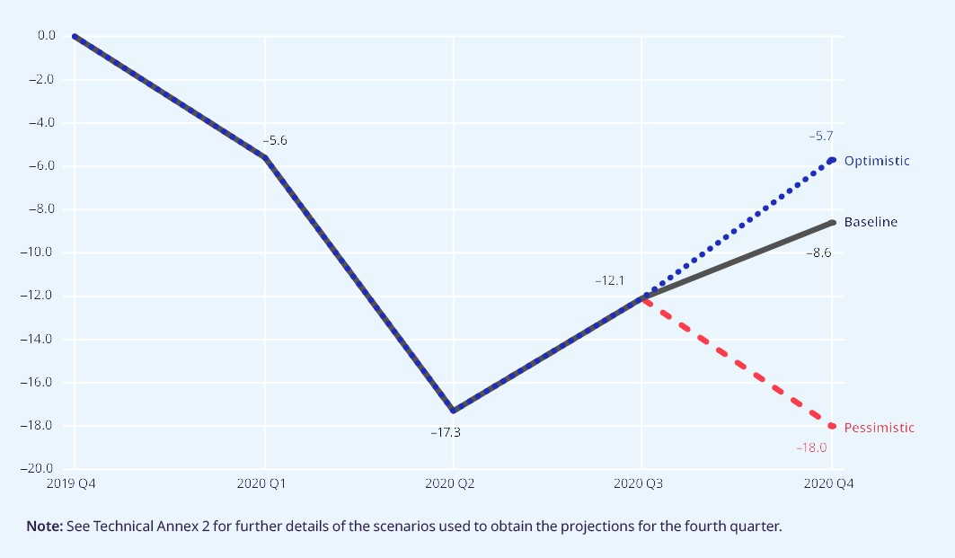
Recovery will be slow, painful and uncertain
  Global working-hour losses are expected to amount to 8.6 per cent in the fourth quarter of 2020, equivalent to 245 million full-time jobs
  Or worse, especially since we now see a resurgence in the virus and new lockdown measures
Source: 6th ILO Monitor.

Slide 7
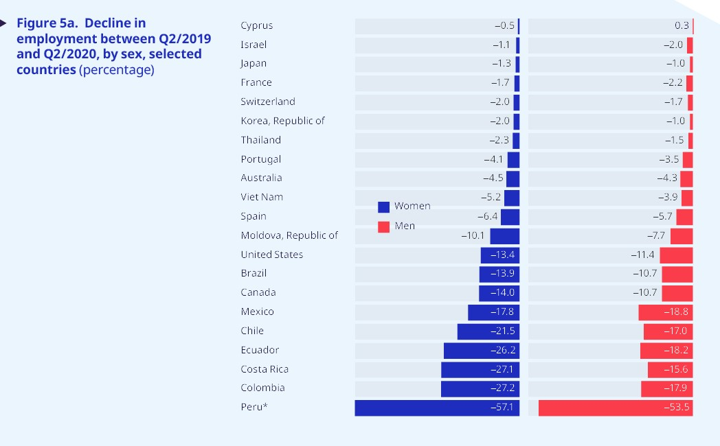
Employment losses in 2020Q2 have been substantial in a number of countries, particularly for women
  Working-hour losses are reflected in a fall in employment – catastrophic declines in the Americas
  Decline in employment numbers has generally been greater for women than for men
  In response, inactivity increased to a greater extent than unemployment
  Rising inactivity is a notable feature of the current job crisis calling for careful monitoring and strong policy attention
Source: 6th ILO Monitor. Peru is for only Lima and its metropolitan area.

Slide 8
The effect on women in the labour force
Employment losses have been stronger among women, risking losing many of the gains made by women around the world
On the supply side, this is driven by an increased care burden for women (closure of childcare and schools, home-schooling, etc.)
On the demand side, women are overrepresented in many sectors hit hardest by lockdowns or losses in demand (e.g. non-food retail, catering and tourism)
Due to worse contractual security, they have been more likely to lose their job
On the flipside, women are overrepresented in front-line occupations, increasing their risk of infection (e.g. health and social care, essential retail)

Slide 9
The fiscal response
Many countries have adopted large‑scale fiscal packages, particularly to support incomes and businesses
In the absence of any fiscal stimulus, global working-hour losses would have been as high as 28 per cent.
So far, the global financial systems has remained relatively stable, and low- and middle income countries (LMIC) have show resilience
Yet, tail risks remain and there is a high level of uncertainty
There remains a substantial funding gap in LMIC → an international response is needed to bridge it

Slide 10
The situation in Portugal (I)
The Portuguese economy contracted slightly more than the Eurozone average, driven by a drop in exports (especially in tourism) and a decline in domestic consumption
Similar to the global trend, Q2 and Q3 saw higher rises in inactivity than in employment – we might see a reversal when temporary measures run out
Contrary to the global trend though, men seem to be more likely to become inactive in Portugal.
→ Mainly driven by prime-age workers and NEETs
Declines in employment strongest among temporary workers – continues challenge of labour market segmentation

Slide 11
The situation in Portugal (II)
A magnified risk of scaring effects for young and prime-age workers, for three reasons:
it is not clear how long the effects of the current crisis are going to last
the current generation of young has already endured a previous severe labour market crisis
there are indications that the current crisis is accelerating structural transformation

Slide 12
Policy strategies for a robust, sustainable and inclusive recovery
  Overall stimulus is still playing a crucial (unprecendeted) role – as at 11 September, fiscal measures are estimated at $11.7 trillion globally, or close to 12 percent of global GDP (IMF)
  Balance and sequence of health, economic, employment and social policy interventions continues to be crucial. Premature loosening of health measures risks prolonging the pandemic, which would worsen its overall labour market impact.
  Support for jobs and labour income will need to continue well into 2021 – to keep employment, businesses and incomes afloat, along with adapting support for growing/target sectors (e.g. care, green, digital economy)
  Solidarity is needed to fill the stimulus gap in low- and middle-income countries
  Income support measures for vulnerable and hard-hit groups, including women, young people and informal workers, should remain a priority, while strengthening social protection system for greater resilience.
  Given the complexity of these challenges, social dialogue has a key role to play.

Slide 13
A human-centered approach
The ILO Centenary Declaration on the Future of Work calls for a human-centered approach to make the future of work what we want it to be. This means increased investment …
  … in people’s capabilities (lifelong learning, supporting people through transitions, a transformative agenda for gender equality)
  … in the institutions of work (respect of Fundamental Principles and Rights at Work, adequate minimum wages, limits on working time, and occupational safety and health as a fundamental right)
  … and in decent and sustainable jobs for the future (making decent employment a central aim of macro policies; trade, industrial and sectoral policies that promote decent work and higher productivity; clear rules for a digitalised world of work, etc.)
    To achieve this, we need to trust and invest in international cooperation, ensure that existing International Labour Standards are the vertebrae of this human-centered recovery, and reach our solutions through social dialogue and compromise.

Slide 14

Thank you!
COVID-19 crisis response:
ILO portal on COVID-19 and the world of work
ILO’s response to the impact of COVID-19 on employment, including
  Rapid assessments and country-level guidelines
  Briefs: National employment policies for an inclusive, job-rich recovery from the COVID-19 crisis
Useful resources

